Slide 1

Using Big Data To Solve
Economic and Social Problems
Professor Raj Chetty
Head Section Leader Rebecca Toseland
Photo Credit: Florida Atlantic University

Slide 2
Missing Applicants to Elite Colleges
What can we do to increase the number of low-income students who attend highly selective colleges?
Hoxby and Avery (2013) show that a key factor is that many low-income, high achieving students do not apply to top colleges

Slide 3
Missing Applicants to Elite Colleges
Data: College Board and ACT data on test scores and GPAs of all graduating high school seniors in 2008
  Also know where students sent their SAT/ACT scores, which is a good proxy for where they applied
Focus on “high-achieving” students: those who score in the top 10% on SAT/ACT and have A- or better GPA

Slide 4
Share of High-Achieving Students by Parent Income Quartile

Slide 5
Costs of Attending Colleges by Selectivity Tier for Low-Income Students
50
Costs for 20th pctile family
Sticker Price
40
30
Avg. Tuition Cost in 2009-10 ($1,000)
20
10
0
Competitive
Private 2-year
Public 2-year
Very competitive
For-profit 2-year
Most competitive
Highly competitive
Competitive plus
Less competitive
Highly competitive plus
Very competitive plus
Some or no selectivity, 4-year

Slide 6
Missing Applicants to Elite Colleges
Next, examine where low-income (bottom quartile) and high-income (top quartile) students apply
Focus on difference between college’s median SAT/ACT percentile and student’s SAT/ACT percentile
  How good of a match is the college for the student’s achievement level, as judged by peers’ test scores?

Slide 7
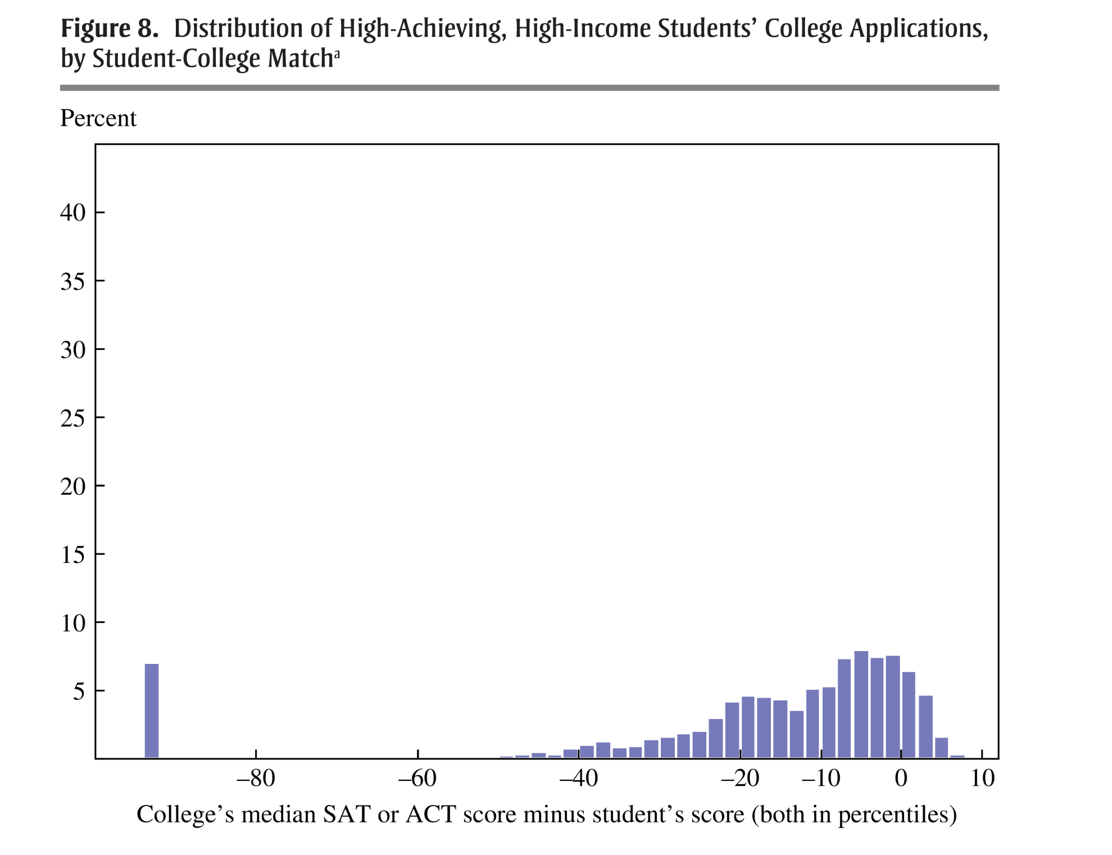

Slide 8
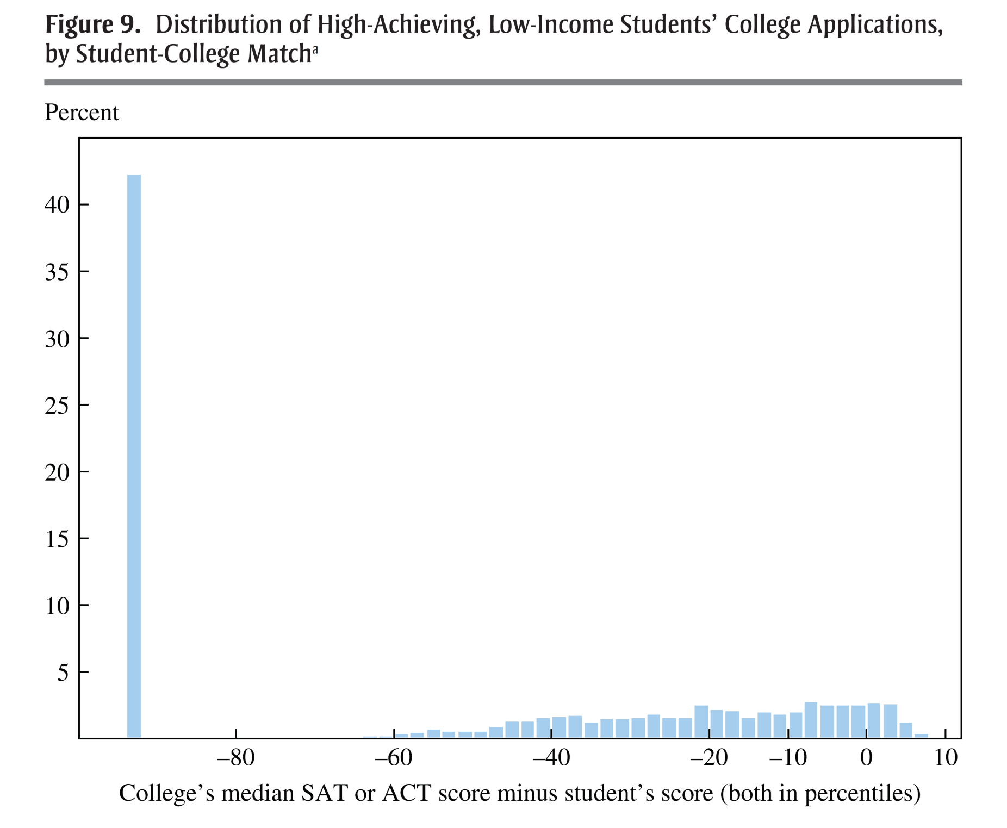

Slide 9
Why Do Many Smart Low-Income Kids
Not Apply to Elite Colleges?
One plausible explanation: lack of information
Children from high-income families have guidance counselors, relatives, and peers who provide advice
Lower-income students may not have such resources
Test this hypothesis by exploring which types of high-achieving low-income students apply to elite colleges
  Compare 8% of students who apply to elite colleges vs. 50% who apply only to non-selective colleges

Slide 10
Geographic Distribution of High-Achieving, Low-Income Students
Students who Apply to Elite Colleges vs. Those Who do Not
25
Apply to Elite Colleges
Apply to Non-Selective Only
20
15
Percent of Students
10
5
0
Urban,
>250k
Urban,
100-250k
Urban,
<100k
Suburb,
>250k
Suburb,
100-250k
Suburb,
<100k
Town,
near city
Town,
not near
city
Rural,
near city
Rural,
not near
city

Slide 11
Why Do Many Smart Low-Income Kids
Not Apply to Elite Colleges?
Further suggestive evidence for information hypothesis: those who apply to elite colleges tend to:
  Live in Census blocks with more college graduates
  Attend schools with many other high achievers who apply to elite colleges (e.g., magnet schools)

Slide 12
Informational Mailings to Low-Income High Achievers
Hoxby and Turner (2013) directly test effects of sending students information on college using a randomized experiment
  Idea: traditional methods of college outreach (visits by admissions officials) hard to scale in rural areas to reach “missing one-offs”
  Therefore use mailings that provide customized information:
    Net costs of local vs. selective colleges
    Application advice (rec letters, which schools to apply to)
    Application fee waivers

Slide 13
Informational Mailings to Low-Income High Achievers
Expanding College Opportunities experimental design:
  12,000 from low-income students who graduated high school in 2012 with SAT/ACT scores in top decile
  Half assigned to treatment group (received mailing)
  Half assigned to control (no mailing)
  Cost of each mailing: $6
  Tracked students application and college enrollment decisions using surveys and National Student Clearinghouse data

Slide 14
Treatment Effect of Receiving Information Packets
Effect on Applying to and Attending a College with SAT Scores Comparable to Student
15
10
Treatment Effect (percentage points)
5
0
Applied
Admitted
Enrolled
Mean:
54.7%
30.0%
28.6%
Pct. Change:
22.3%
31.0%
18.5%

Slide 15
Missing Applicants to Elite Colleges: Lessons
Part of the reason there are so few low-income students at elite colleges like Stanford is that smart, low-income kids don’t apply
This phenomenon is partly driven by a lack of exposure, consistent with other evidence on neighborhood effects
Low-cost interventions like informational mailings can close part of the application gap
  But kids from low-income families remain less likely to attend elite colleges

Slide 16
Directions for Future Work on Higher Education
Using Big Data
How can we further increase access to elite colleges to provide more pathways to upper-tail outcomes?
  Identify more highly qualified low-income children who are not currently being admitted and/or not applying using outcome data
  Can we reach such students using social networks?
How can we expand access to colleges that may be “engines of upward mobility”?
  Estimate value-added of high-mobility-rate colleges using experiments/quasi-experiments and study their recipe for success

Slide 17
K-12 Education

Slide 18
K-12 Education: Background
U.S. spends nearly $1 trillion per year on K-12 education
Decentralized system with substantial variation across schools
  Public schools funded by local property taxes → sharp differences in funding across areas
  Private schools and growing presence of charter schools

Slide 19
K-12 Education: Overview
Main question: how can we maximize the effectiveness of this system to produce the best outcomes for students?
  Traditional approach to study this question: qualitative work in schools
  More recent approach: analyzing big data to evaluate impacts
References:
  Chetty, Friedman, Hilger, Saez, Schanzenbach, Yagan. “How Does Your Kindergarten Classroom Affect Your Earnings? Evidence from Project STAR” QJE 2011.
  Reardon, Kalogrides, Fahle, Shores. “The Geography of Racial/Ethnic Test Score Gaps.” Stanford CEPA Working Paper 2016
  Fredriksson, Ockert, Oosterbeek. “Long-Term Effects of Class Size.” QJE 2012
  Chetty, Friedman, Rockoff. “Measuring the Impacts of Teachers I and II” AER 2014

Slide 20
Using Test Score Data to Study K-12 Education
Primary source of big data on education: standardized test scores obtained from school districts
  Quantitative outcome recorded in existing administrative databases for virtually all students
  Observed much more quickly than long-term outcomes like college attendance and earnings

Slide 21
Using Test Score Data to Evaluate Primary Education
Common concern: are test scores a good measure of learning?
  Do improvements in test scores reflect better test-taking ability or acquisition of skills that have value later in life?
Chetty et al. (2011) examine this issue using data on 12,000 children who were in Kindergarten in Tennessee in 1985
  Link school district and test score data to tax records
  Ask whether KG test score performance predicts later outcomes

Slide 22




A Kindergarten Test
I’ll say a word to you. Listen for the ending sound.
You circle the picture that starts with the same sound
“cup”

Slide 23


Earnings vs. Kindergarten Test Score
$25K
$20K
Average Earnings from Age 25-27
$15K
Note: R² = 5%
$10K
0
20
40
60
80
100
Kindergarten Test Score Percentile

Slide 24
Earnings vs. Kindergarten Test Score
$25K
Binned scatter plot: dots show average earnings
for students in 5-percentile bins
Ex: students scoring between 45-50 percentile
earn about $17,000 on average
$20K
Average Earnings from Age 25-27
$15K
Note: R² = 5%
$10K
0
20
40
60
80
100
Kindergarten Test Score Percentile

Slide 25
Earnings vs. Kindergarten Test Score
$25K
But lot of variation in students’
earnings around the average
in each bin
$20K
Average Earnings from Age 25-27
$15K
Note: R² = 0.05
$10K
0
20
40
60
80
100
Kindergarten Test Score Percentile

Slide 26
Earnings vs. Kindergarten Test Score
$25K
$20K
Average Earnings from Age 25-27
$15K
Test scores explain only 5% of the
variation in earnings across students
Note: R² = 5%
$10K
0
20
40
60
80
100
Kindergarten Test Score Percentile

Slide 27
Earnings vs. Kindergarten Test Score
$25K
Lesson: KG Test scores are highly predictive of
earnings…but they don’t determine your fate
$20K
Average Earnings from Age 25-27
$15K
Note: R² = 5%
$10K
0
20
40
60
80
100
Kindergarten Test Score Percentile

Slide 28

College Attendance Rates vs. KG Test Score
80%
60%
Attended College before Age 27
40%
20%
0%
0
20
40
60
80
100
Kindergarten Test Score Percentile

Slide 29

Marriage by Age 27 vs. KG Test Score
55%
50%
45%
Married by Age 27
40%
35%
30%
25%
0
20
40
60
80
100
Kindergarten Test Score Percentile

Slide 30
Studying Differences in Test Score Outcomes
Test scores can provide a powerful data source to compare performance across schools and subgroups (e.g., poor vs. rich)
Problem: tests are not the same across school districts and grades → makes comparisons very difficult
Reardon et al. (2016) solve this problem and create a standardized measure of test score performance for all schools in America
  Use 215 million test scores for students from 11,000 school districts across the U.S. from 2009-13 in grades 3-8

Slide 31
Making Test Score Scales Comparable Across the U.S.
Convert test scores to a single national scale in three steps:
  Rank each school district’s average scores in the statewide distribution (for a given grade-year-subject)
  Use data from a national test administered to a sample of students by Dept. of Education to convert state-specific rankings to national scale
    Ex: suppose CA students score 5 percentiles below national average
    Then a CA school whose mean score is 10 percentiles below CA mean is 15 percentiles below national mean
  Convert mean test scores to “grade level” equivalents

Slide 32
Nationwide District Achievement Variation, 2009-2013

Slide 33
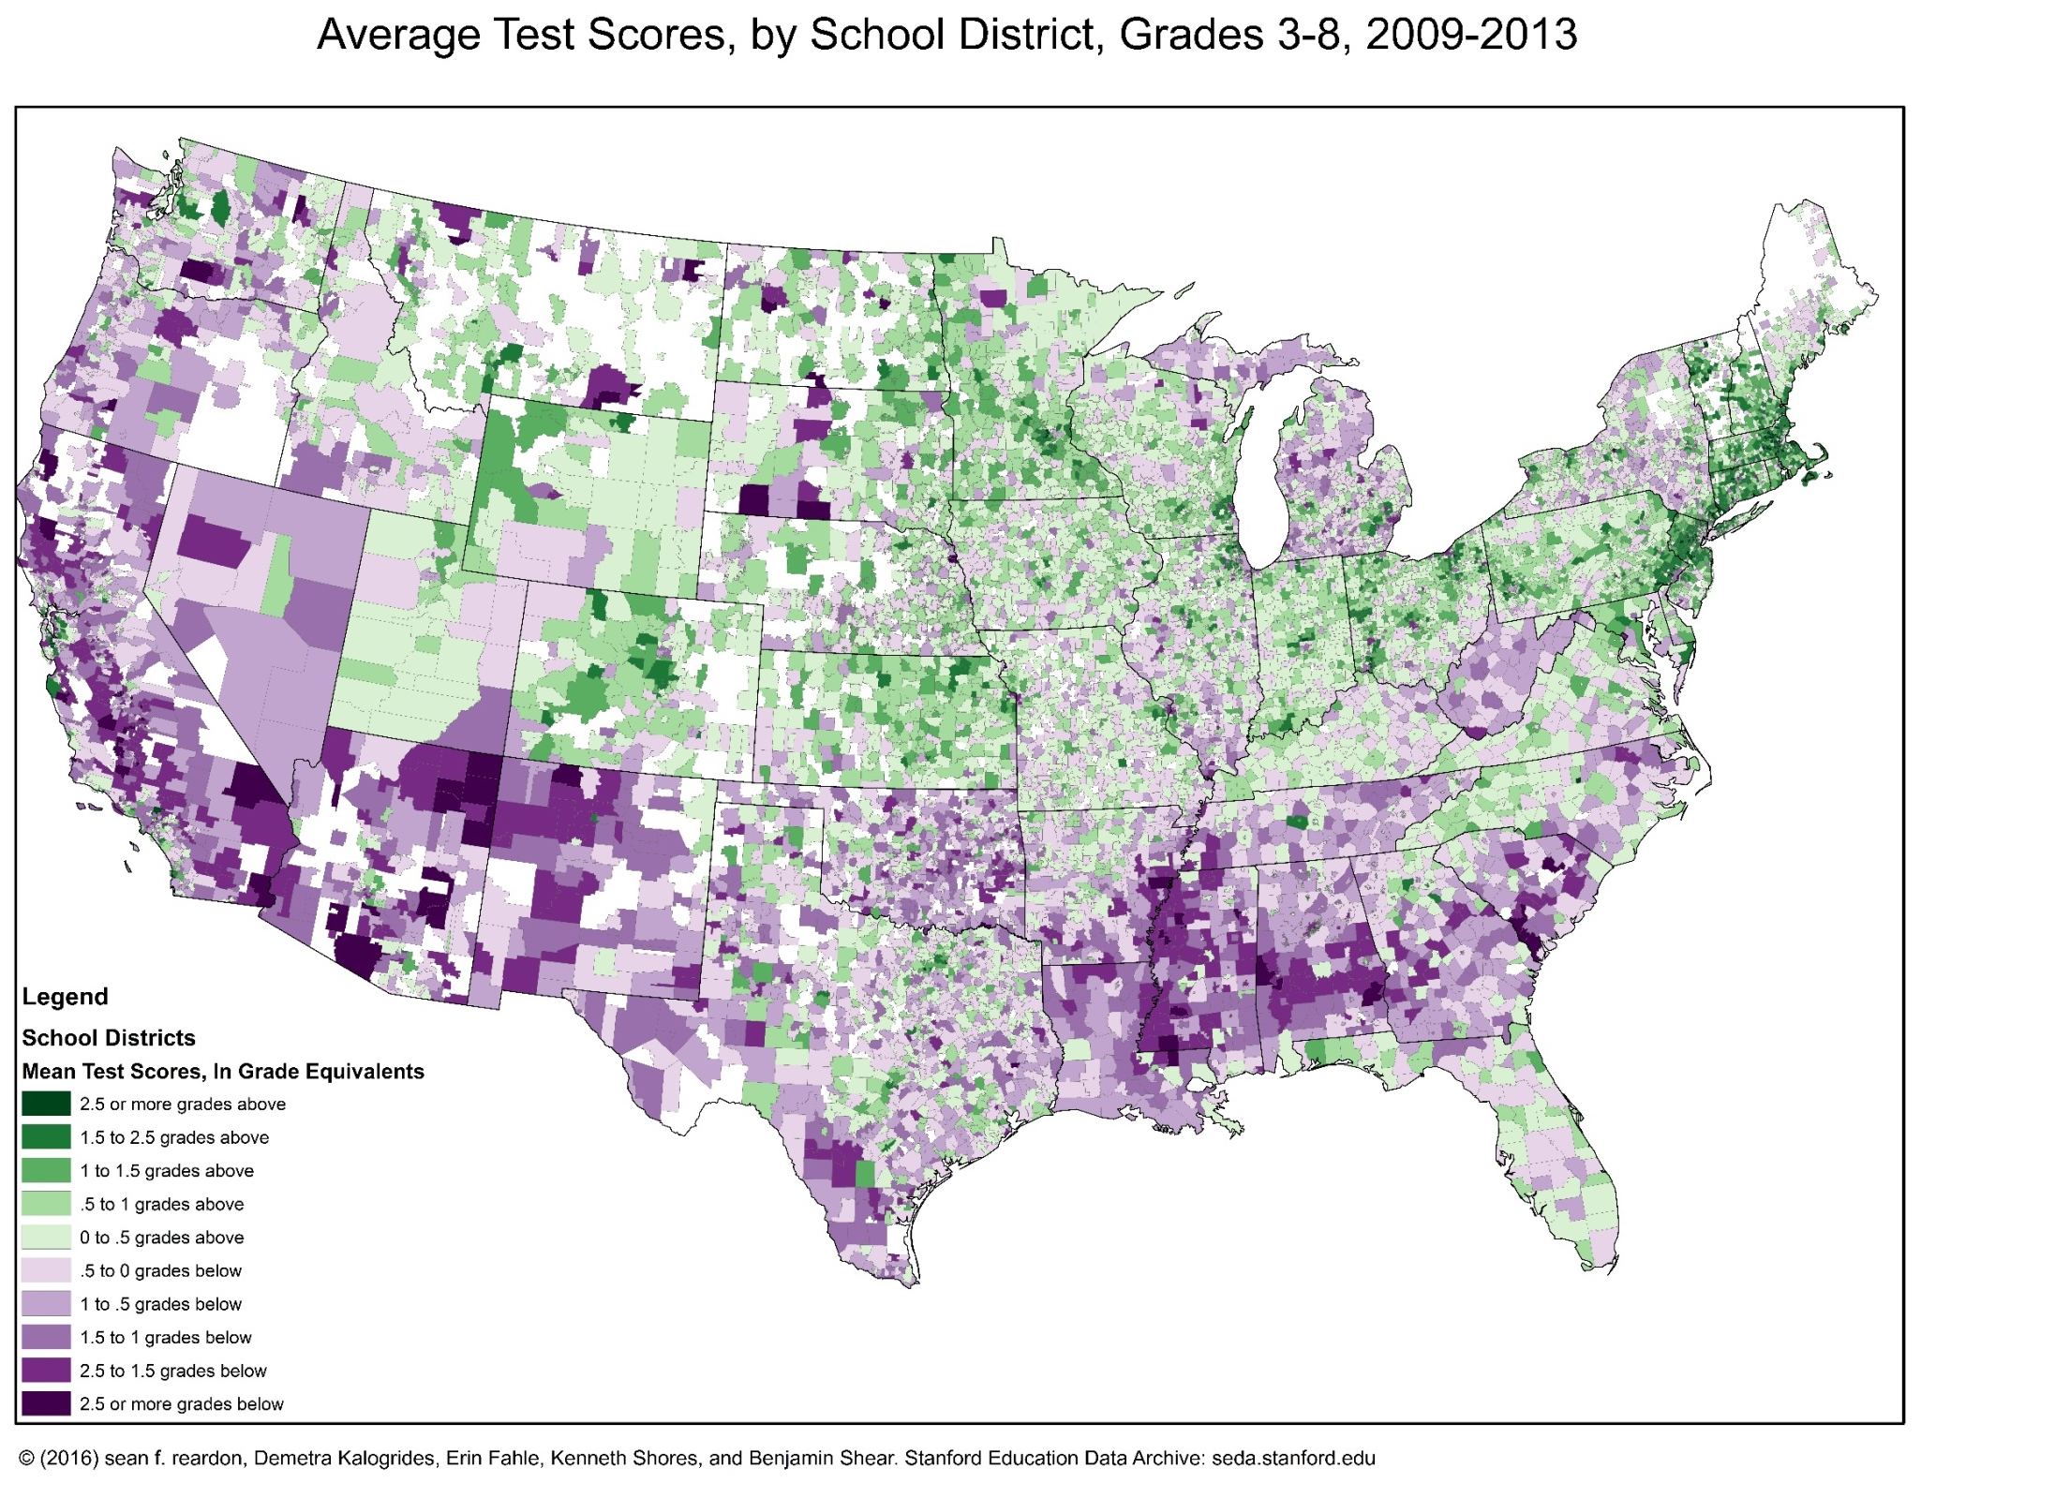

Slide 34
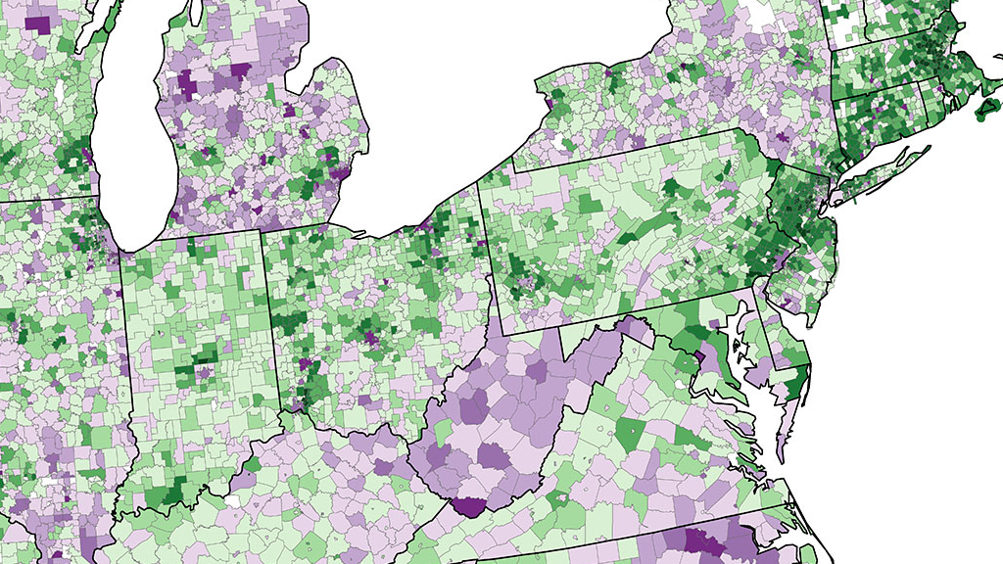

Slide 35
Achievement Gaps in Test Scores by Socioeconomic Status
Next, use these data to examine how test scores vary across socioeconomic groups
Define an index of socioeconomic status (SES) using Census data on income, fraction of college graduates, single parent rates, etc.

Slide 39
How Can We Improve Poorly Performing Schools?
There are many school districts in America where students are two grade levels behind national average, controlling for SES
How can we improve performance in these schools?
  Simply spending more money on schools is not necessarily the solution…

Slide 40
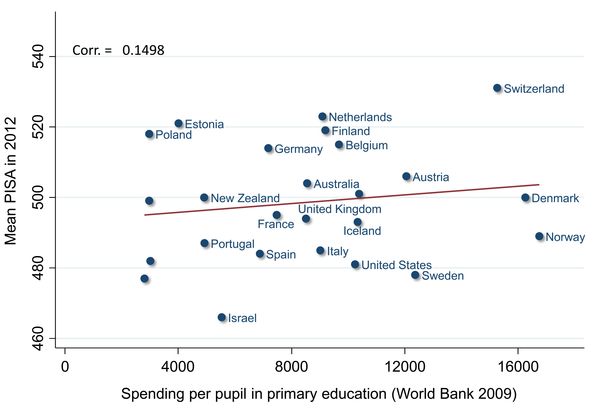
Test Scores vs. Expenditures on Primary Education Across Countries

Slide 41
Two Policy Paradigms to Improve Schools
Two distinct policy paradigms to improve schools
  Government-based solutions: improve public schools by reducing class size, increasing teacher quality, etc.
  Market-based solutions: charter schools or vouchers for private schools
Contentious policy debate between these two approaches
  We will consider each approach in turn

Slide 42
Government-Based Solutions: Improving Schools

Slide 43



Improving Schools: The Education Production Function
Improving public schools requires understanding the education production function
How should we change schools to produce better outcomes?
  Better Teachers? Smaller Classes? Better Technology?

Slide 44
Effects of Class Size
Begin by analyzing effects of class size
Cannot simply compare outcomes across students who are in small vs. large classes
  Students in schools with small classes will generally be from higher-income backgrounds and have other advantages
  Therefore simply comparison in observational data will yield overstate causal effect of class size
Need to use experimental/quasi-experimental methods instead

Slide 45
Effects of Class Size: Tennessee STAR Experiment
Student/Teacher Achievement Ratio (STAR) experiment
  Conducted from 1985 to 1989 in Tennessee
  About 12,000 children in grades K-3 at 79 schools
Students and teachers randomized into classrooms within schools
  Class size differs: small (~15 students) or large (~22 students)
  Classes also differ in teachers and peers

Slide 46
Effects of Class Size: Tennessee STAR Experiment
Evaluate impacts of STAR experiment by comparing mean outcomes of students in small vs. large classes
Report impacts using regressions of outcomes on an indicator
(0-1 variable) for being in a small class [Krueger 1999, Chetty et al. 2011]

Slide 47
STAR Experiment: Impacts of Class Size
Dep Var: | Test Score | College Attendance | Earnings
 | (1) | (2) | (3)
Small Class | 4.81 | 2.02% | -$4
 | (1.05) | (1.10%) | ($327)
Observations | 9,939 | 10,992 | 10,992
Mean of Dep. Var. | 48.67 | 26.4% | $15,912
Outcome
Notes:
47

Slide 48
STAR Experiment: Impacts of Class Size
Dep Var: | Test Score | College Attendance | Earnings
 | (1) | (2) | (3)
Small Class | 4.81 | 2.02% | -$4
 | (1.05) | (1.10%) | ($327)
Observations | 9,939 | 10,992 | 10,992
Mean of Dep. Var. | 48.67 | 26.4% | $15,912
Estimated
Impact
Estimated impact of being in a small KG class:
4.81 percentile gain in end-of-KG test score
Notes:
48

Slide 49
STAR Experiment: Impacts of Class Size
Dep Var: | Test Score | College Attendance | Earnings
 | (1) | (2) | (3)
Small Class | 4.81 | 2.02% | -$4
 | (1.05) | (1.10%) | ($327)
Observations | 9,939 | 10,992 | 10,992
Mean of Dep. Var. | 48.67 | 26.4% | $15,912
Standard
Error
95% chance that estimate lies within +/-2 times standard error
test score impact between 2.71 and 6.91 percentiles
Repeat experiment 100 times → 95 of the 100 estimates will lie
between 2.71 and 6.91 percentiles
Notes:
49

Slide 50
STAR Experiment: Impacts of Class Size
Dep Var: | Test Score | College Attendance | Earnings
 | (1) | (2) | (3)
Small Class | 4.81 | 2.02% | -$4
 | (1.05) | (1.10%) | ($327)
Observations | 9,939 | 10,992 | 10,992
Mean of Dep. Var. | 48.67 | 26.4% | $15,912
Mean Value
of Outcome
Notes:
50

Slide 51
STAR Experiment: Impacts of Class Size
Dep Var: | Test Score | College Attendance | Earnings
 | (1) | (2) | (3)
Small Class | 4.81 | 2.02% | -$4
 | (1.05) | (1.10%) | ($327)
Observations | 9,939 | 10,992 | 10,992
Mean of Dep. Var. | 48.67 | 26.4% | $15,912
Notes:
51

Slide 52
STAR Experiment: Impacts of Class Size
Dep Var: | Test Score | College Attendance | Earnings
 | (1) | (2) | (3)
Small Class | 4.81 | 2.02% | -$4
 | (1.05) | (1.10%) | ($327)
Observations | 9,939 | 10,992 | 10,992
Mean of Dep. Var. | 48.67 | 26.4% | $15,912
95% chance that estimate lies within +/-2 times standard error
→ Earnings impact could be as large as $650 (4% increase)
Notes:
52

Slide 53
Effects of Class Size: Quasi-Experimental Evidence
Limitation of STAR experiment: insufficient data to estimate impacts of class size on earnings precisely
Fredriksson et al. (2013) use administrative data from Sweden to obtain more precise estimates
  No experiment here; instead use a quasi-experimental method: regression discontinuity

